Slide 1
Introduction
The COVID-19 pandemic has irrevocably changed the world. The COVID-19 pandemic has irrevocably changed the world. This analysis focuses on data from [2020] to [2024] in [countries/regions].The project was gotten from https://ourworldindata.org/covid-deaths

Slide 2
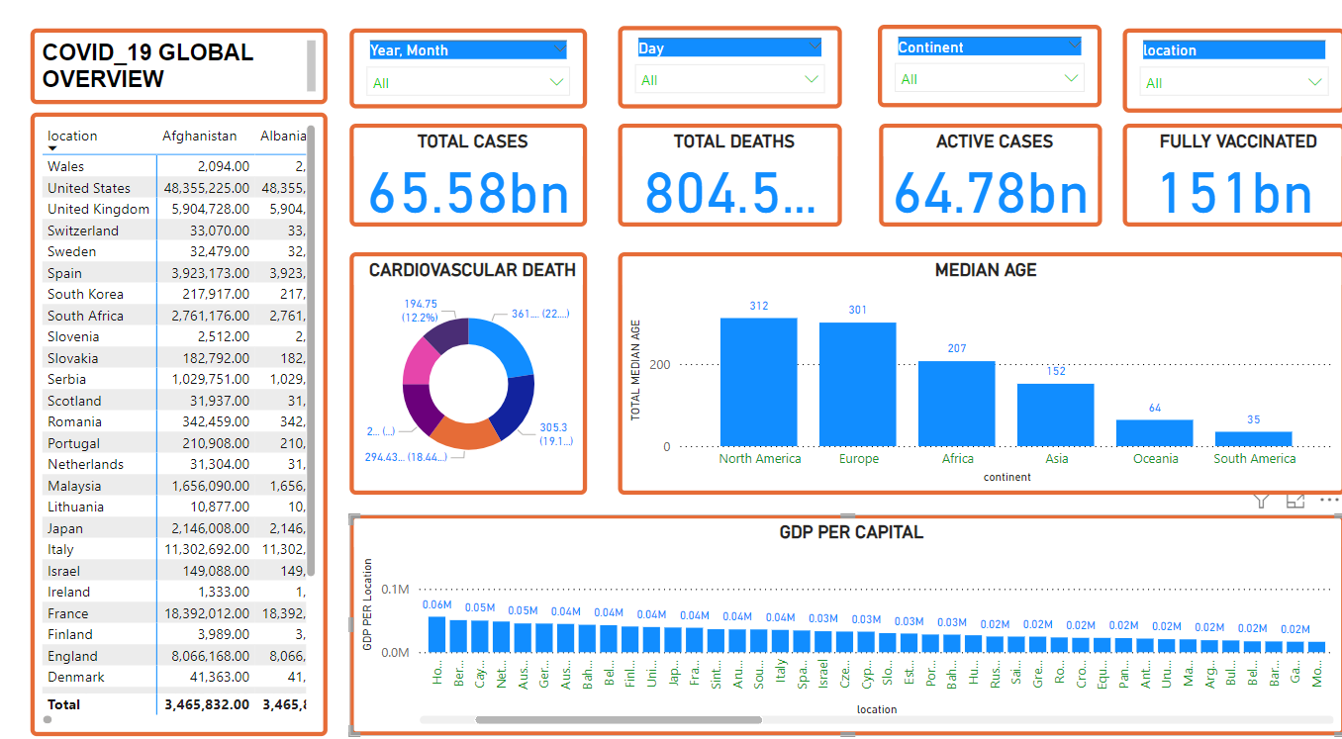
Data Overview
This is an overview of the data of the continents with the total cases, total deaths, active cases and fully vaccinated. It also look at the age group of elders within the age limit of 65 to 75 and how the pandemic affect the GDP per capital of each country.

Slide 3
Key finding & insight
Case numbers peaked in [octomber,2021] and have been steadily declining since[January, 2022]. There is a strong correlation between vaccination and decreased hospitalization. The decline in case numbers was because of the implemented public health measures are effective. There is also an increased in the death of cardiovascular patient which is also during the pandemic has a higher rate of people in the Oceania continent. The life expectancy during the pandemic is slow at the sum of 72.78 which is low. The total ICU patient per day in each location increases in the year 2020

Slide 4
Conclusion
The COVID-19 pandemic has presented unprecedented challenges to global health and economies. Our analysis reveals [The decline in life expectancy and also the increase on cardiovascular death]. These findings underscore the importance of [the negligent in the stringency measure of the government to reduce the impact of covid_19].

Slide 5
Reference
Mr. Jonathan Ogwumike,CDA,GBIP – Hiit Plc

